Slide 1

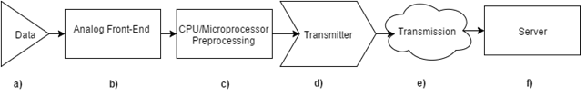
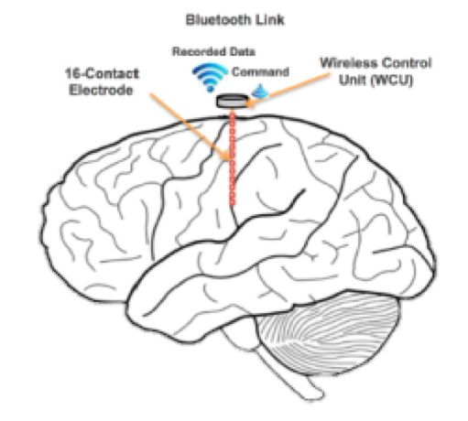
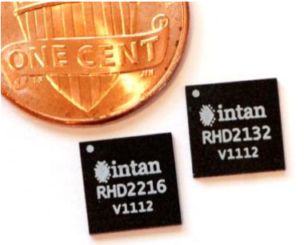


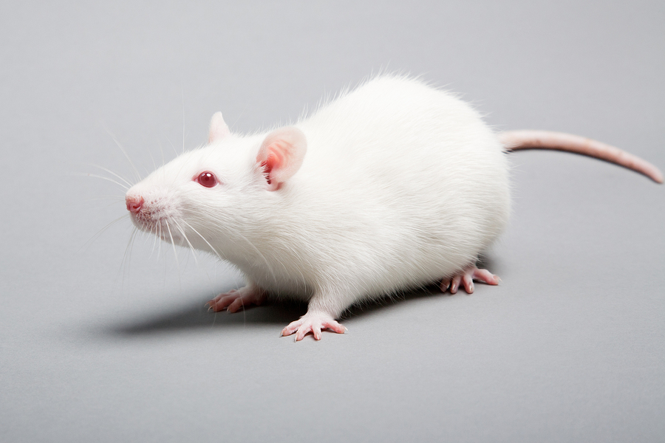
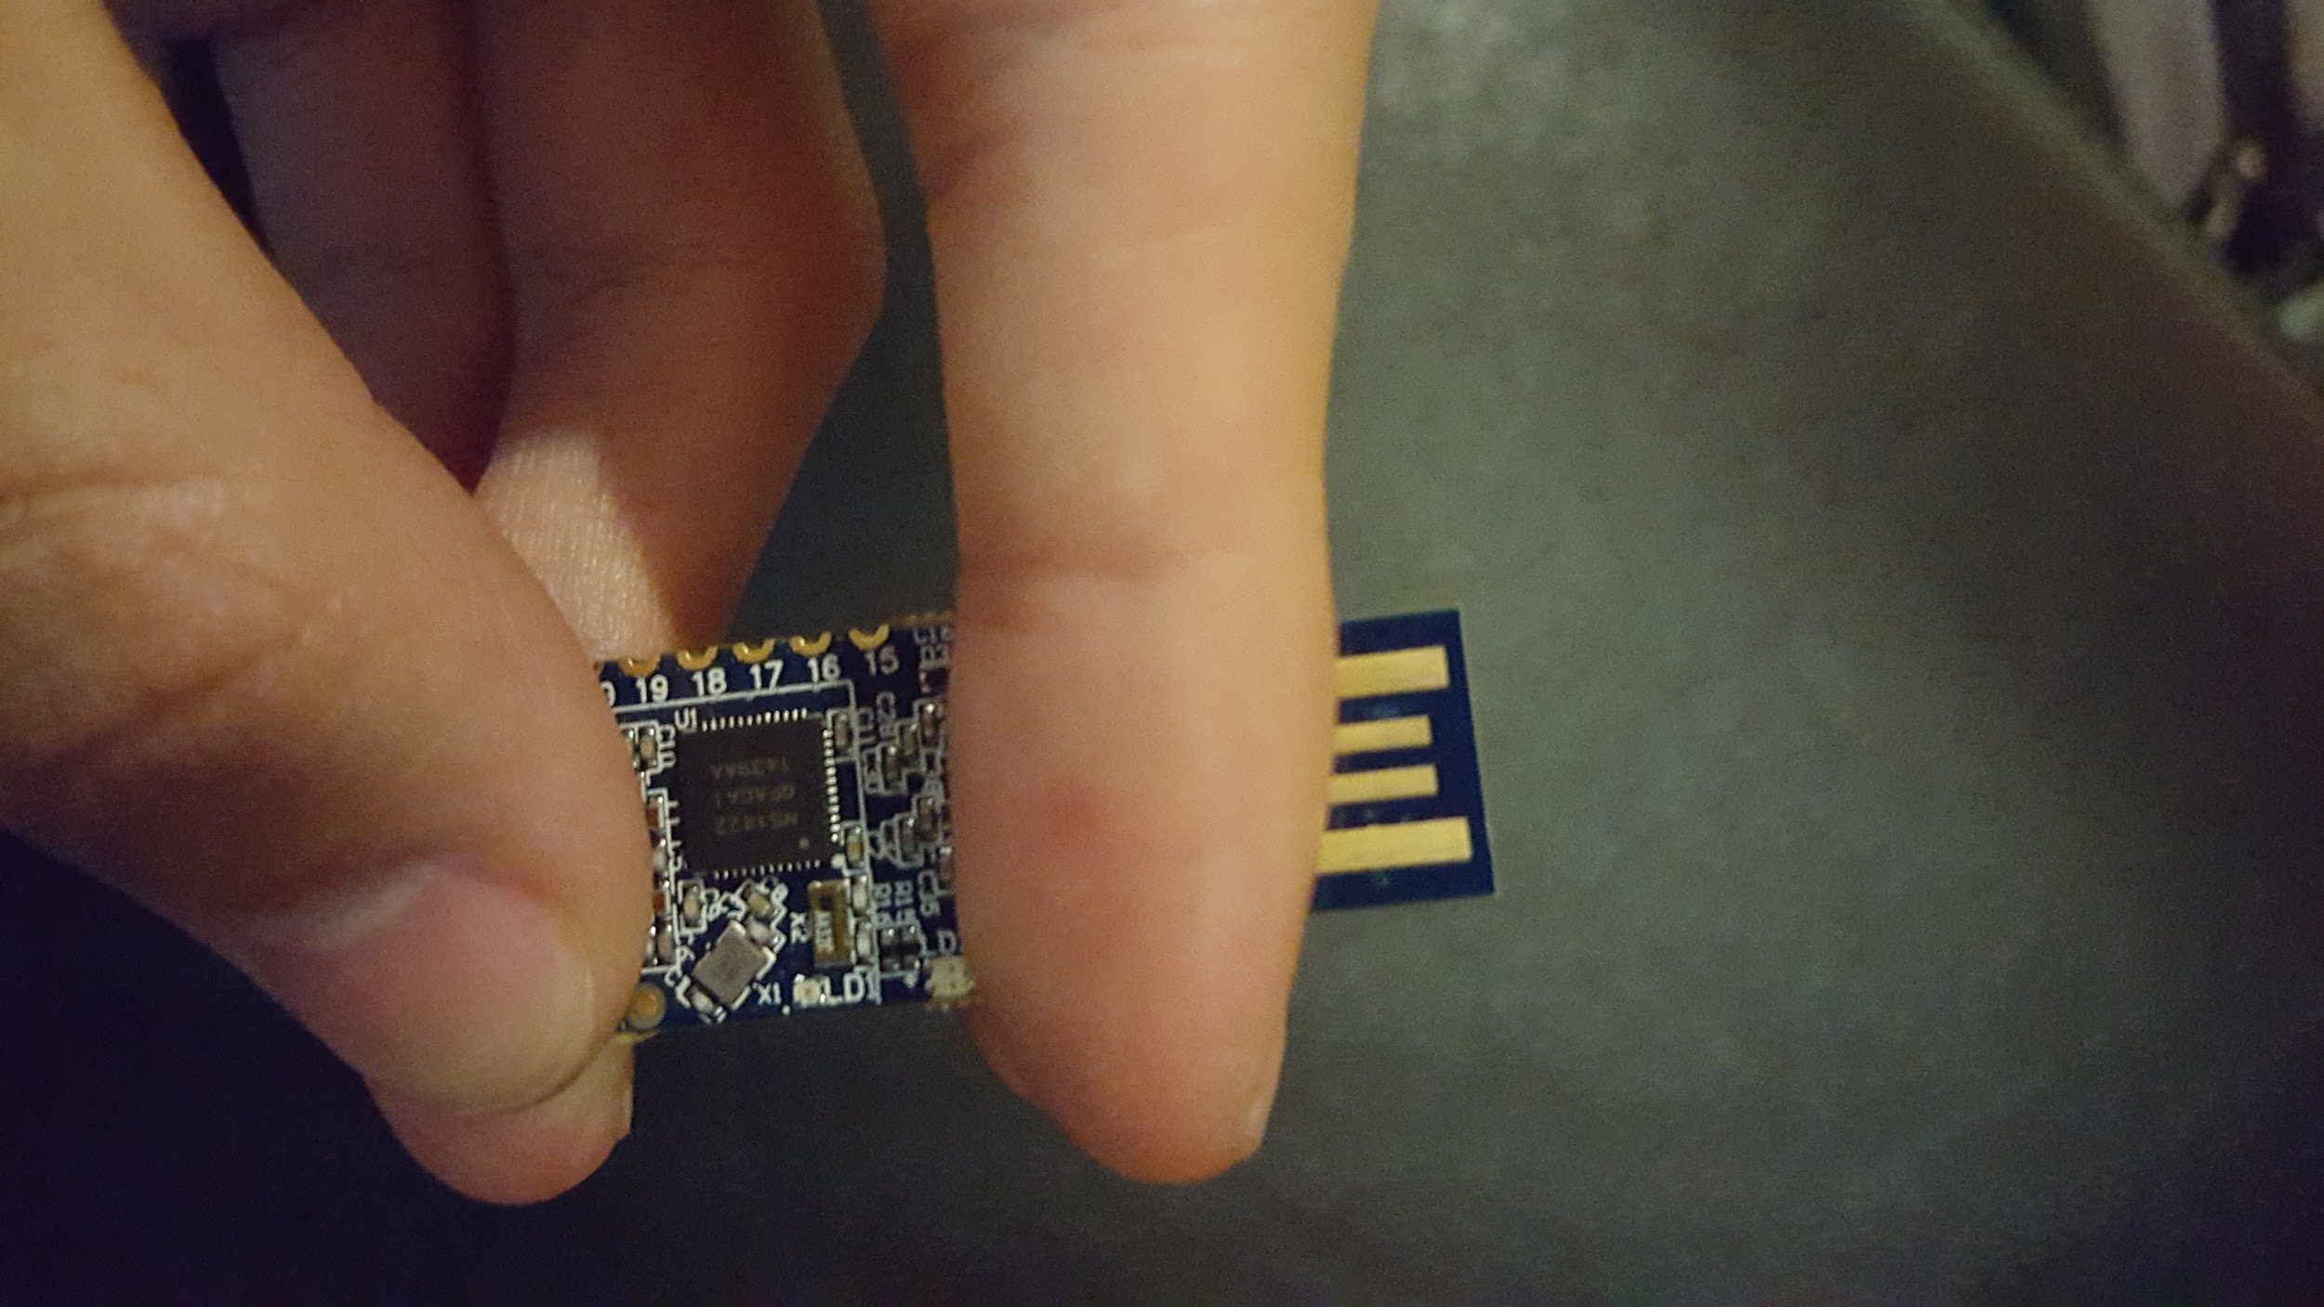




Wireless Neural Recorder
Yuan Gao, Tingkai Liu, Xin Huang, Stephen Xia
Department of Electrical and Computer Engineering, Rice University
Project Description
Engineering Design for a Single Wireless Control Unit
Currently, no solution exists on the market for an efficient recording of neural brain activity that is not restricted by a physical tether. Our project goal is to develop a low-power wireless recording device that digitizes neural signals from a 16-channel, 16-element electrode array and send the neural data wirelessly to a portable receiver. The wireless neural recorder will first be wireless embedded ECoG system implemented in animals and eventually humans.
System Design Goal
To design a small, power-efficient wireless add-on to neural electrode.
Design Specifications
Electrode Array
Analog Front-End
Bluetooth Low Energy
Receiver
Array of 16 electrodes
Each electrode outfitted with a wireless control unit (WCU)
Each WCU samples neural data and transmits in real-time to a secure terminal
Intan RHD2000
Specialized neural recording chip
Protective circuitry
Nanovolt precision
Nordic NRF52
6x6 QFN
Upwards of 2 Mbits/s
Compression
Secure Terminal
Communicates with the BLE transmitters on the probes
Data presentation and analysis
Prototype
Next Steps
Wireless Control Unit Specifications
16 Channel Neural Electrode Sampling
Each channel needs to sampled at 1 kHz
Data fidelity: 8-bit Data Precision
Compact Form Factor: No larger than 15 x 15 x 15 mm
Operating battery life: > 24 hours
Begin animal testing with functional prototype
Custom IC: ideally should fit within 8 x 8 x 8 mm
WiFi HaLow: Increase data rate beyond BLE products
Areas of Impact
PCB+ELECTRODE Images (When we get them)
Hospitals/Clinics
Research Institutions
Households
Acknowledgement
We would like to thank Dr. Gary Woods, Professor in the Practice of ECE, Rice University for his assistance and mentorship in guiding us through the product and technical development process; Dr. Aydin Babakhani, Assistant Professor of ECE, for his technical mentorship and support; Hamed Rahmani, Ph.D. student, for his technical mentorship and support; and Dr. Nitin Tandon, Neurosurgeon in the Texas Medical Center, for bringing the project into fruition and his support.
Special Thanks to the Brenner Foundation with Ellen Kirk and resources of the Oshman Engineering Design Kitchen. Without them, this project would not be possible.

